Slide 1
Identifying and Profiling High-CLV Customers in E-Commerce
By Ahsan Mubarak

Slide 2
Business Context and Objective
Context:
In the highly competitive world of e-commerce, Customer Lifetime Value (CLV) is one of the most important KPIs for assessing customer performance. Customers with high-CLV have the potential to contribute significantly to long-term revenue. That’s why it’s crucial for companies to identify and profile high-CLV customers to create more targeted sales strategies.
Objective:
The aim of this analysis is to identify and profile high-CLV customers on e-commerce platforms. By gaining a deeper understanding of who these high-CLV customers are, companies can make more direct and informed decisions regarding sales strategies, pricing, and campaign segmentation.

Slide 3
Dataset Overview
Dataset: E-commerce Customer Behavior
Source: Kaggle - E-commerce Customer Behavior
This dataset provides a detailed view of customer behavior on an e-commerce platform. Each row represents a unique customer, including their transaction history and interaction patterns.
This dataset includes:
Customer ID
Total Spend
Item Purchased
Membership Type
Satisfaction Level
City

Slide 4
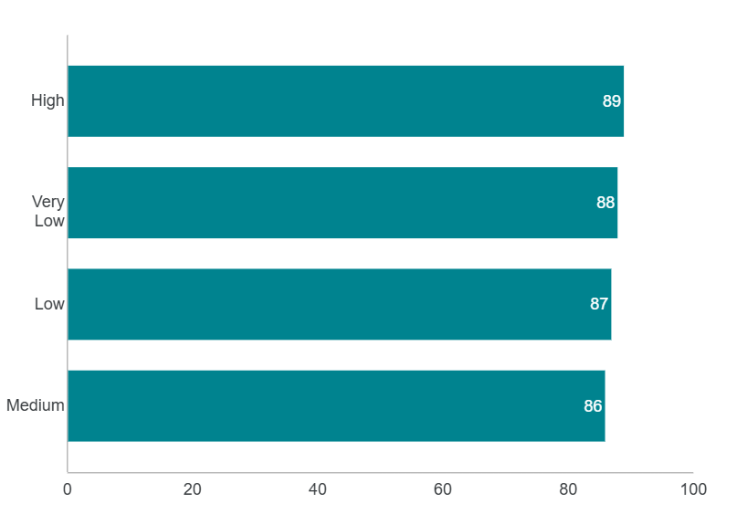
CLV Category Distribution
Insight:
The CLV values are tightly clustered between 86 and 89, indicating limited variation across customers. This suggests segmentation based on small behavioral differences.

Slide 5
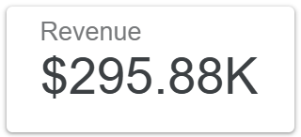
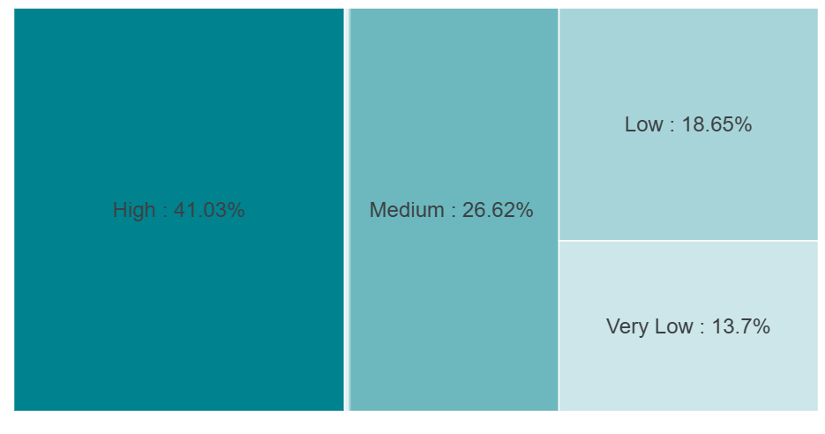
Revenue Distribution by CLV Category
Insight:
High-CLV contributed 41% for revenue or around $120.000
Medium 26% around $76.000
Low and very low 32% around $94.000

Slide 6
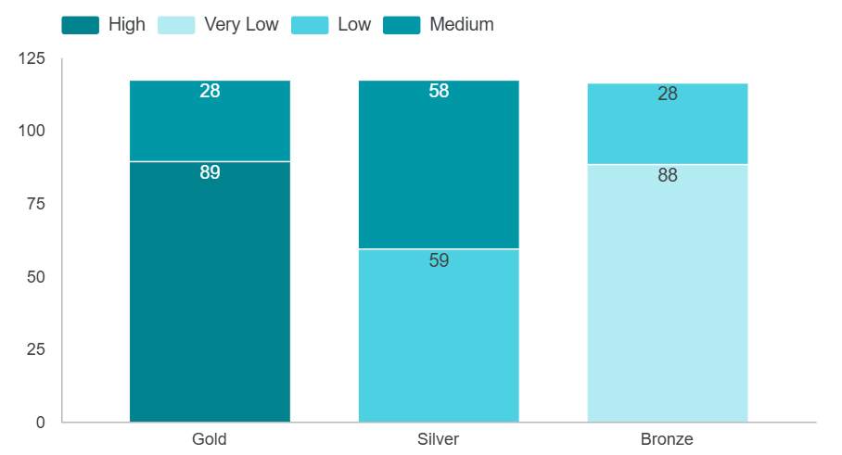
CLV Category by Membership Type
Insight:
All High-CLV customers are Gold members, highlighting a strong link between membership tier and customer value.
Among Medium-CLV customers, 76% hold Silver memberships, while only 24% are in Gold.

Slide 7
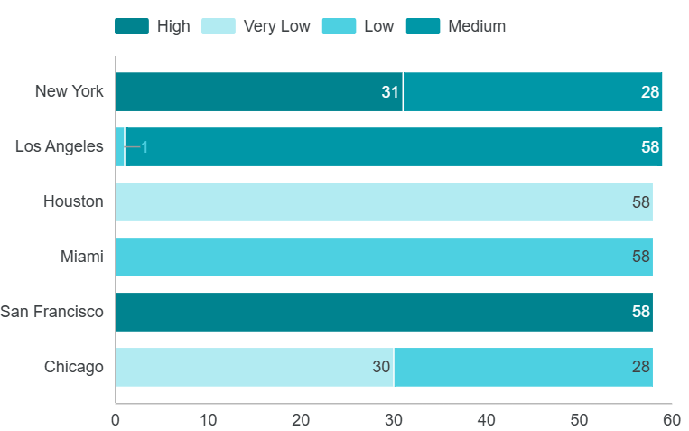
Location-based CLV Distribution
Insight:
San Francisco: 100% of customers High-CLV
Los Angeles: 91% Medium-CLV, only 9% High
New York: Mixed, 60% Medium and 40% High
San Francisco shows strong customer potential. New York and Los Angeles also show growth opportunities if targeted properly.

Slide 8
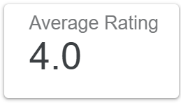
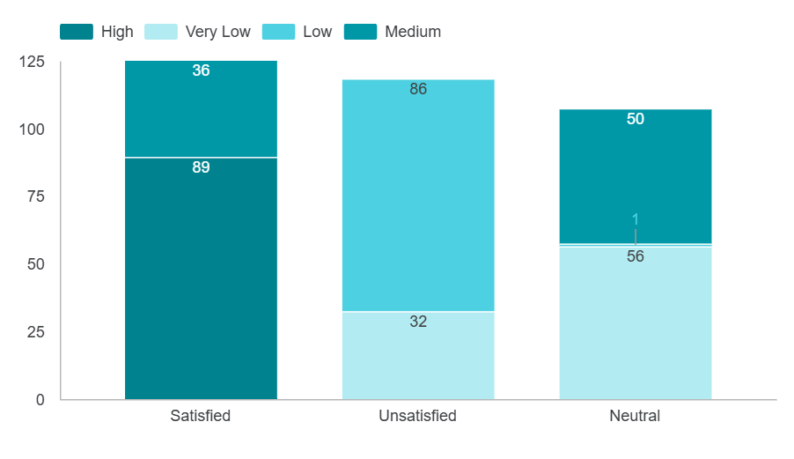
Customer Satisfaction by CLV Category
Insight:
All High-CLV customers report being satisfied with the service.
Meanwhile, Medium-CLV customers are split: 58% are satisfied, while 42% are neutral.
Customer satisfaction plays a critical role in driving value. Improving satisfaction could directly impact loyalty and revenue.

Slide 9
Final Insight and Recommendation
Final Insight:
This analysis shows that high-value customers tend to be:
Gold members
Satisfied with service
Located in San Francisco

Slide 10
Final Insight and Recommendation
Recommendation:
Focusing on San Francisco, New York, and Los Angeles for customer retention and expansion efforts
Promoting Gold membership upgrades through targeted campaigns
Enhancing the overall customer experience to boost satisfaction and long-term loyalty
By focusing on these segments and strategies, the business can improve retention and maximize lifetime value across key regions.

